Slide 1

DATABASE ON COLLEGE MANAGEMENT SYSTEM
Presented By :
GAYAM PURUSHOTHAM

Slide 2
What Is SQl: Structured query language (more often known as SQL) is the programming language specially designed to help user in manipulating data that are stores in relational database management system RDBMS. It has five different types of commands:
1) DDL : Data Definition language
2) DQL : Data Query Language
3) DML : Data Manipulation Language
4) DCL : Data Control Language
5) TCL : Transactional Control Language

Slide 3
1) DDL : Data Definition language
2) DQL : Data Query Language
CREATE
ALTER
RENAME
TRUNCATE
DROP
SELECT
3) DML : Data Manipulation Language
INSERT
DELETE
UPDATE
4) DCL : Data Control Language
5) TCL : Transactional Control Language
GRANT
REVOKE
COMMIT
ROLLBACK
SAVE POINT
SET TRANSACTION

Slide 4
COLLEGE MANAGEMENT SYSTEM It manages the complete student lifecycle, departments, faculty, as well as non-faculty in the college. It also manages the academic, administrative, and fee management and all other financial activities of a college.
College Data Management System gives a straightforward interface to support of understudy data, staff information, attendance, fee record. It very well may be utilized by instructive establishments or schools to keep up the records of understudies without any problem.

Slide 5
COLLEGE MANAGEMENT
STUDENTS
Id
fname
llname
gender
degree
course
attendance
percentage
mob_number
mail_id
TEACHING FACULTY
Id
faculty_name
department
qualification
designation
doj(Date Of Joing)
experience
salary
Non-Teaching Faculty
Id
name
department
designation
salary
DEPARTMENTS
Id
degree
d_name
d_code
duration
fee
JOB OPENINGS
Id
position
qualification
experience
TRANSPORTATION
van_number
places
morning_timings
evening_timings
ADMISSIONS
a_id
s_name
mobile_number
mail_id
course_enrolled
admission_date
admission_time
entreance_rank

Slide 6
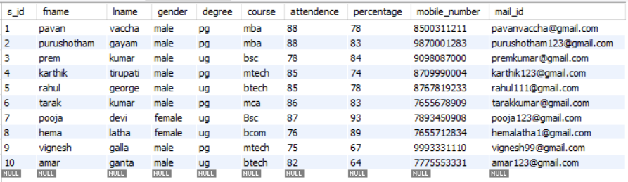
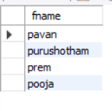



STUDENTS TABLE
create table students(s_id int not null auto_increment,primary key(s_id),fname varchar(50),lname varchar(50),gender varchar(50),degree varchar(50),course varchar(50),attendence int,percentage int,mobile_number varchar(90),mail_id varchar(50));
>>To display all the values we use “*”
Select * from students table;
>>To display the full name of the students who’s percentage in the range of 80-90 and having the attendance more than 80%?
select concat_ws(" ",fname,lname) as "students who have 80-90 percentage and attendance more than 80" from students where (percentage between 80 and 90) and attendence>80 ;
>>Find how many male and female members are there?
select gender,count(gender) as "No. of Male & Female students" from students group by gender;
>>Display the name who’s names start with “P”?
select fname from students where fname like "p%";
>>find number of students who took the course MBA?
select count(fname) as "No. of students who took MBA COURSE" from students where course="mba";

Slide 7
Displaying all the values in students table;
>>To display the full name of the students who’s percentage in the range of 80-90 and having the attendance more than 80%?
>>Display the name who’s names start with “P”?
>>Find how many male and female members are there?
>>find number of students who took the course MBA?

Slide 8
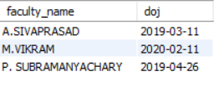
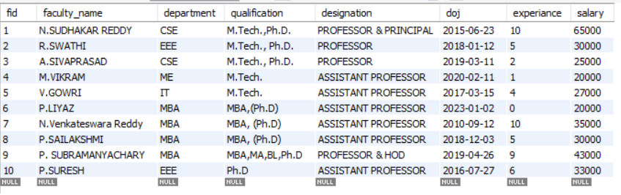

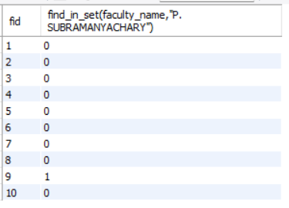
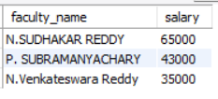

TEACHING FACULTY TABLE
create table teaching_faculty(fid int not null auto_increment,primary key(fid),faculty_name varchar(80),department varchar(90),qualification varchar(90),designation varchar(90),doj date,experiance int,salary int);
>>To display all the values in the table?
Select * from teaching_faculty;
>>Display the name who has joined between the years 2019 and 2023?
select faculty_name,doj from teaching_faculty where doj between "2019-01-01" and "2023-01-01“ ;
>>Display the names and designation who has most working experience?
select faculty_name,designation from teaching_faculty where experiance in (select max(experiance) from teaching_faculty);
>>Display the salary of assistant professor who belongs to EEE Department?
select designation,department,salary from teaching_faculty where designation="assistant professor" and department="eee";
>>Find the id of the faculty who’s name is “P.SUBRAMANYACHARY”?
select fid,find_in_set(faculty_name,"P. SUBRAMANYACHARY") from teaching_faculty;
>>Display the three faculty names, salary and arrange the salary in descending order ?
select faculty_name,salary from teaching_faculty order by salary desc limit 3;

Slide 9
Displaying all the values in teaching faculty;
>>Find the id of the faculty who’s name is “P.SUBRAMANYACHARY”?
>>Display the three faculty names, salary and arrange the salary in descending order ?
>>Display the name who has joined between the years 2019 and 2023?
>>Display the names and designation who has most working experience?
>>Display the salary of assistant professor who belongs to EEE Department?

Slide 10
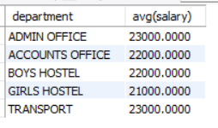
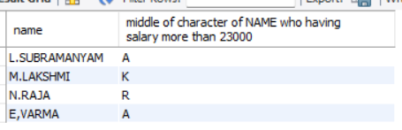
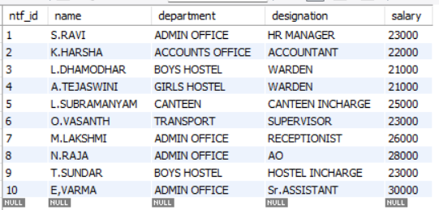
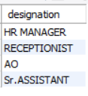

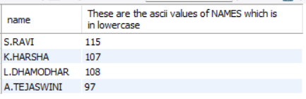
TEACHING FACULTY TABLE
create table nonteaching_faculty(ntf_id int not null auto_increment,primary key(ntf_id),name varchar(90), department varchar(90),designation varchar(90),salary int);
>>To display all the values in the table?
Select * from nonteaching_faculty;
>>Display four names and find the ascii value of names?
select ascii(lower(name)) as "These are the ascii values of NAMES which is in lowercase" from nonteaching_faculty limit 4;
>>Find the average salary of each department?
select department,avg(salary) from nonteaching_faculty where salary<(select avg(salary) from nonteaching_faculty) group by department;
>>Display the names “M.Lakshmi” and “O.VASANTH”?
select name from nonteaching_faculty where name in ( "O.VASANTH","M.LAKSHMI");
>>Extract the middle of the character of name whose salary is greater than 23000?
select name,substr(name,char_length(name)/2,1) as "middle of character of NAME who having salary more than 23000" from nonteaching_faculty where salary>23000;
>>Display the admin office designation?
select designation from NONTEACHING_FACULTY where department="admin office";

Slide 11
Displaying all the values in nonteaching faculty;
>>Display four names and find the ascii value of names?
>>Find the average salary of each department?
>>Extract the middle of the character of name whose salary is greater than 23000?
>>Display the names “M.Lakshmi” and “O.VASANTH”?
>>Display the admin office designation?

Slide 12
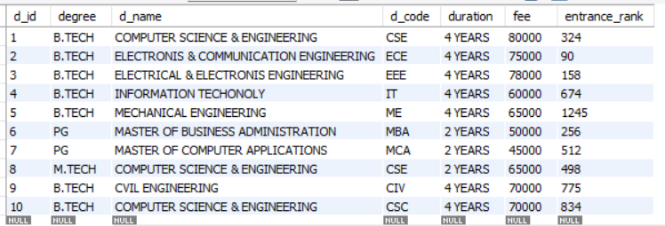
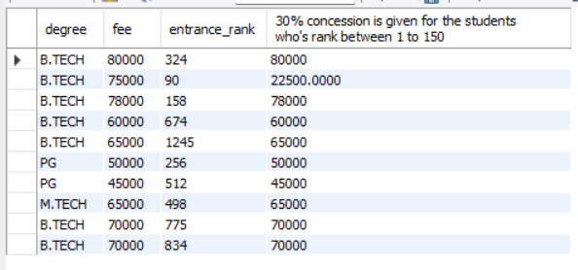

DEPARTMENTS TABLE
create table departments(d_id int not null auto_increment,primary key(d_id),degree varchar(90),d_name varchar(90),d_code varchar(90),duration varchar(90),fee int);
>>To display all the values in the table?
Select * from departments;
>>Add column name entrance marks in the department table and insert the random values between 1 to 7000?
alter table departments add column entrance_rank int;
>>Display the least fee?
select min(fee) from departments;
>>Display all the table values and give 30% fee concession for the students who got entrance_rank between 1 to 150?
select degree,fee,entrance_rank, if(entrance_rank between 1 and 150,(30/100*fee),fee) as "30% concession is given for the students who's rank between 1 to 150" from departments;

Slide 13
>>Add column entrance_marks to the departments tables and insert the random values between 1 to 7000?
>>Display all the table values and give 30% fee concession for the students who got entrance_rank between 1 to 150?
>>Display the least fee?

Slide 14
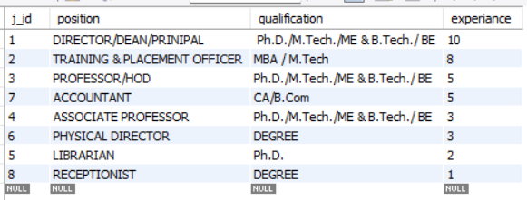

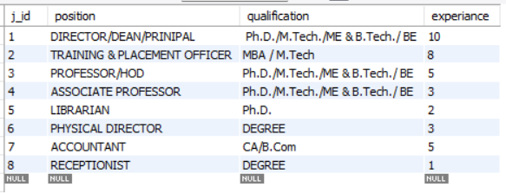

JOB OPENINGS TABLE
create table job_openings(j_id int not null auto_increment,primary key(j_id), position varchar(90),qualification varchar(90),experiance int);
>>To display all the values in the table?
Select * from job_openings;
>>display the qualification for "ASSOCIATE PROFESSOR“?
select qualification from job_openings where position="associate professor";
>>How is experience is needed for the position of "DIRECTOR/DEAN/PRINIPAL“?
select experiance as "DIRECTOR/DEAN/PRINIPAL Experiance" from job_openings where position="DIRECTOR/DEAN/PRINIPAL" ;
>>Display all the values and arrange the experience in descending order ?
select * from job_openings order by experiance desc;

Slide 15
Displaying all the values in the job openings table
>>How is experience is needed for the position of "DIRECTOR/DEAN/PRINIPAL“?
>>display the qualification for "ASSOCIATE PROFESSOR“?
>>Display all the values and arrange the experience in descending order?

Slide 16
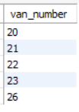
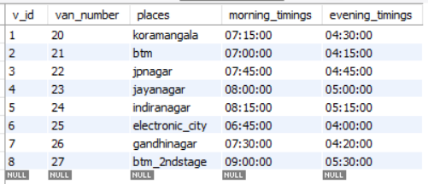


TRANSPORTATION TABLE
create table transportation(v_id int not null auto_increment,primary key(v_id),van_number int,places varchar(50),morning_timings time, evening_timings time);
>>To display all the values in the table?
Select * from transportation;
>>What are the morning and evening timings for the “van number 24” ?
select morning_timings,evening_timings from transportation where van_number=24;
>>Display the van numbers which runs between 7AM and 8AM ?
select van_number from transportation where morning_timings between "07:00:00" and "08:00:00";
>>Display the timings and van number which will go to the place “Jayanagar” ?
select van_number,morning_timings,evening_timings from transportation where places="jayanagar";

Slide 17
Displaying all the values in the transportation table
>>What are the morning and evening timings for the “van number 24” ?
>>Display the van numbers which runs between 7AM and 8AM ?
>>Display the timings and van number which will go to the place “Jayanagar” ?

Slide 18
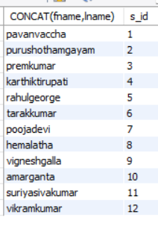
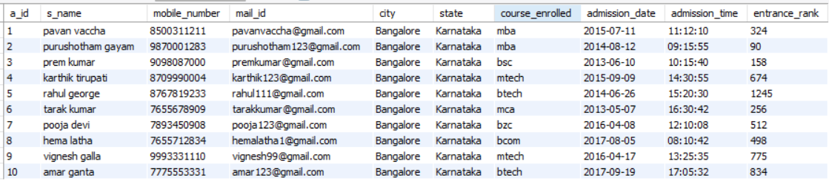
ADMISSION TABLE
CREATE TABLE admissions(a_id INT,FOREIGN KEY(a_id) REFERENCES students(s_id),s_name VARCHAR(50),mobile_number VARCHAR(90),mail_id VARCHAR(50),city VARCHAR(50) DEFAULT 'Bangalore',state VARCHAR(50) DEFAULT 'Karnataka',course_enrolled VARCHAR(50) ,admission_date DATE,admission_time TIME,entrance_rank INT);
FOR JOINS :
We have inserted two more values in students tables to get the left, right, and full join.
To insert the values in students table:
INSERT INTO students(fname,lname,gender,degree,course,attendence,percentage,mobile_number,mail_id) VALUES ("suriya","sivakumar","male","ug","btech",76,84,"7775553674","suriya123@gmail.com"), ("vikram","kumar","male","pg","mtech",82,79,"8976943331","vikram546@gmail.com");
Than take the all values from admission table:
Select * from admissions;

Slide 19
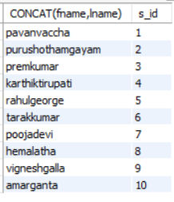
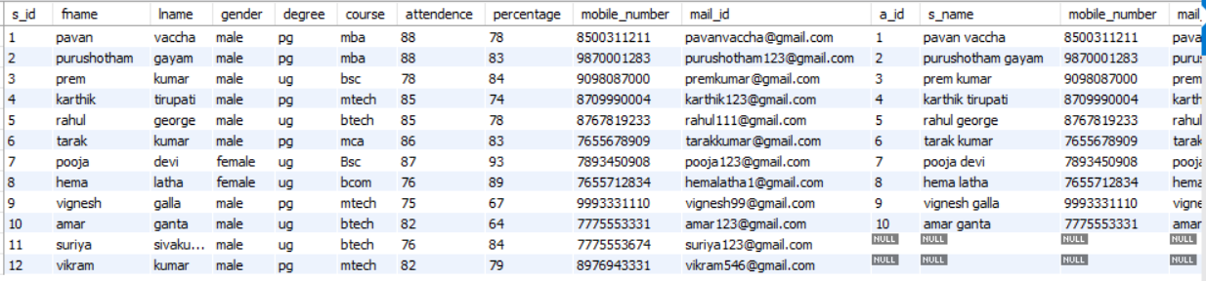
Displaying all the values in admissions table;
LEFT JOIN IS USED: The students id is compared to admission id which is child tables.
SELECT CONCAT(fname,lname),s_id FROM students LEFT JOIN admissions ON students.s_id=admissions.a_id;

Slide 20
RIGHT JOIN IS USED: The students id is compared to admission id which is child tables.
SELECT CONCAT(fname,lname),s_id FROM students RIGHT JOIN admissions ON students.s_id=admissions.a_id;
FULL JOIN IS USED:
select * from students right join admissions on students.s_id=admissions.a_id union select * from students left join admissions on students.s_id=admissions.a_id

Slide 21
CONCLUSION
In our project college management system we have stored all the sample data regarding student details, faculty and non-faculty staff, departments, fee structure, transportations, and admission data which is helpful to the admin office to filter the data of different departments and collects the data which is required.
SQL database management application which is very well used in the modern world in organizing and manipulating a database.
Though SQL doesn’t have the GUI interface like Microsoft access is having and they all manage the database comfortable..
Depending on the user if organization has multiple user then they should go for SQL sever based application.
This project shows how to create table in SQL and how to create simple data manipulation language and data definition language with how to execute them.
It also shows how relationship are established with the concepts of primary and foreign key within a table.

Slide 22


